Slide 1

Data Processing and Information Retrieval of Atmospheric Measurements
Group Number:- 3

Slide 2

OUTLINE
This research work produces clean, standardized, and redundancy-free atmospheric science data by processing and retrieving information from raw data. The two major tasks are data processing and information retrieval. Fuzzy matching and fuzzy rule-based inference engine are used to remove inaccuracies, resolve inconsistencies, and consolidate information. A rule-based system is used to categorize the type of measurement. A preprocessor based on NLP aids in retrieving instrument information, and a fuzzy rule-based system is used to determine the instrument type.

Slide 3

PROBLEM STATEMENT
The problem addressed by this research is the need to clean and standardize atmospheric science data for real-world applications. Raw data can be inaccurate and inconsistent, making it difficult to use. The goal is to develop a system that can effectively process and retrieve information from raw data to produce high-quality, usable data.

Slide 4
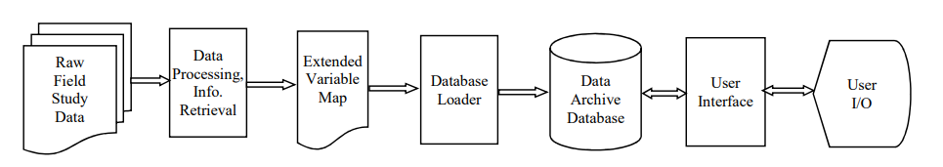
EXISTING METTHOD

Slide 5
COMPARATIVE ANALYSIS OF ALGORITHMS
 | FUZZY RULE | FORWARD CHAINING SYSTEM
Definition | Fuzzy logic is a mathematical approach that deals with reasoning that is approximate rather than exact. It is used to handle uncertain and ambiguous data | It is a reasoning technique that starts with the given data and works forward to draw conclusions.
Decision Making | It is particularly suited to situations where the decision-making process involves a lot of uncertainty and imprecision. It is useful when there is a lot of data with no clear boundary between what is true and what is not | It is useful when the decision-making process involves a lot of logic and reasoning. It is particularly useful in expert systems where the expert knowledge is organized as a set of rules.

Slide 6
 | FUZZY RULE | FORWARD CHAINING SYSTEM
Rule | Rules are expressed in terms of fuzzy sets, which are sets of values with degrees of membership between 0 and 1. | Rules are expressed in the form of "if-then" statements.
Execution | The system executes all the rules simultaneously and generates a fuzzy output, which represents the degree of membership of the input to each output. | The system executes each rule in sequence until it reaches a conclusion.
Complexity | It is generally more complex than forward chaining, as it involves dealing with fuzzy sets and the concept of degrees of membership | It is a more straightforward approach that involves working through a set of rules.
Performance | Fuzzy logic can be slower than forward chaining, as it involves executing all the rules simultaneously. | Forward chaining can be faster, as it executes each rule in sequence.

Slide 7

IMPLEMENTATION
Program to identify data inconsistency using fuzzy’s rule and removing it using Forward chaining method.

Slide 8
METHOD
RAW DATA AS INPUT
DATA PREPROCESSING
INFORMATION RETRIEVAL
OUTPUT
START
The data processing involves removing inaccuracies and resolving inconsistencies among data.
Information retrieval involves identifying the information needed, extracting the data, and consolidating similar entries.
clean, standardized, and redundancy-free data as output

Slide 9
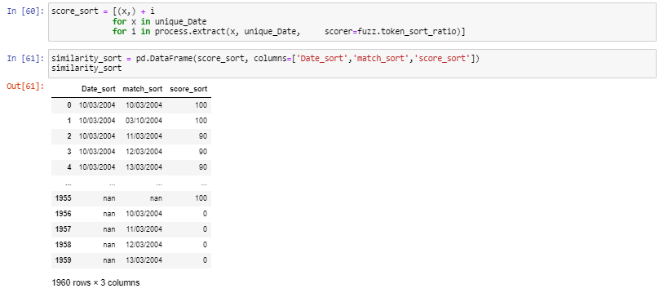
OUTPUT

Slide 10
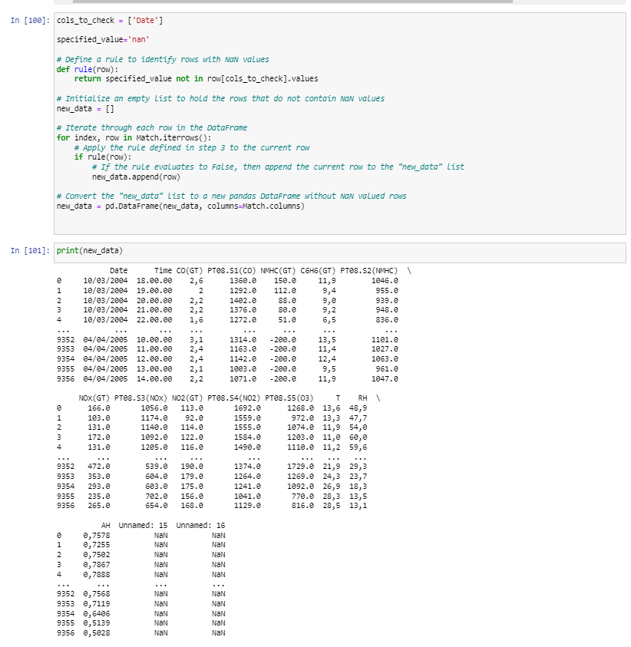

Slide 11
ADVANTAGES
Comprehensive and scalable strategy.
Performed as effectively across a variety of data sets.
Handling of uncertainty
Versatility
Robustness
Transparency

Slide 12
RESULT ANALYSIS
Data quality metrics : This could be used to determine the quality of the data and identify areas for improvement.
Performance metrics : This metrics could be used to evaluate the effectiveness of the techniques used in the research work
Comparison with existing methods : This could be done to determine the superiority of the new techniques used in the research work.
Case studies : This could be done to demonstrate the effectiveness of the techniques used in the research work and their potential for solving real-world problems.

Slide 13
OBTAINED RESULT VS DESCRIBED RESULT
OBTAINED RESULTS | DESCRIBED RESULTS
Used one dataset to obtain the result. | In order to test the effectiveness of the development, it was used to process the data archives generated by 10 different projects over a period of 15 years.
No Database injection. | These were the data sets undergoing the database ingestion process during the period of this research work.
The research paper provide us the clean, standardized and redundancy free data, Which we are able to generate. As this is a small process, we thought to develop the further process (Analysis Phase).

Slide 14
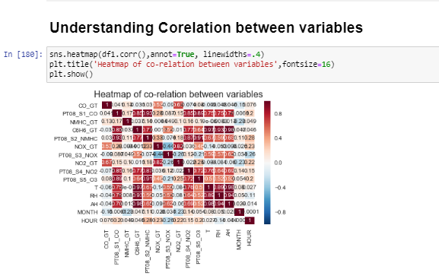
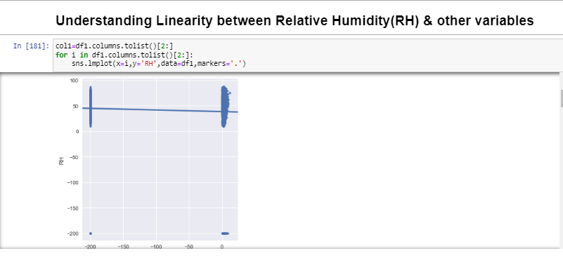
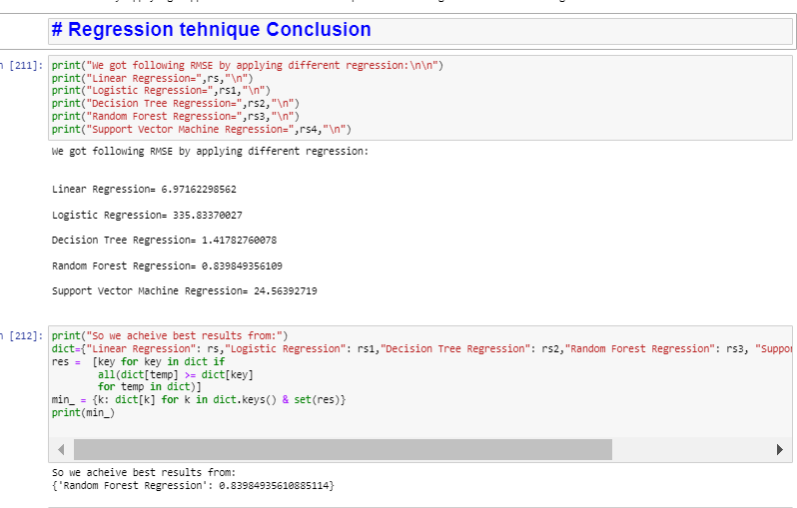
For Analysis purpose, we used various MACHINE LEARNIG Algorithms and obtained 1.Understanding Corelation between variables
2.Understanding Linearity between Relative Humidity(RH) & other variables
3.By using different regression techniques, we can retrieve the RH value and able to find the best regression technique. The analysis involved fitting several machine learning models to the training data, including Random Forest, Support Vector Machine (SVM), and Gradient Boosting. The performance of these models was evaluated using several metrics, including accuracy, precision, recall, and F1-score.

Slide 15

LIMITATIONS
The use of numerous algorithms added to the complexity.
There was no information supplied on correctness and efficiency.
Lack of standardization
Difficulty in optimization
Incomplete reasoning
Lack of formal semantics

Slide 16

Applications
Weather forecasting: The clean and standardized data generated by this work could be used as input for weather forecasting models. Accurate weather forecasts are essential for various industries, such as agriculture, transportation, and energy.
Climate modeling: Climate models require high-quality data to simulate the behavior of the earth's climate system. The clean and standardized data generated by this work could be used to improve the accuracy of climate models.
Air quality analysis: The quality of the air we breathe is critical to our health and well-being. The clean and standardized data generated by this work could be used to analyze air quality and identify the sources of pollutants.
Environmental monitoring: The clean and standardized data generated by this work could be used for environmental monitoring, such as monitoring changes in the atmosphere due to human activities, such as industrial emissions or land-use changes.
Research: The clean and standardized data generated by this work could be used for research purposes in atmospheric science, such as studying the effects of climate change on the atmosphere or investigating the behavior of specific pollutants.
Overall, this research work has the potential to benefit various industries and scientific fields by providing high-quality data for analysis and decision-making.

Slide 17

CITATIONS
[1] A. Aknan, G. Chen, J. Crawford, and E. Williams, ICARTT File Format Standards V1.1, 2013.
[2] M. E. Lesk and E. Schmidt, Lex: A Lexical Analyzer Generator, 1975
[3] Graham Hutton, "Higher-order functions for parsing", Journal of Functional Programming. 2 (3): 323–343, 1992
[4] Richard Frost, Rahmatullah Hafiz, "A New Top-Down Parsing Algorithm to Accommodate Ambiguity and Left Recursion in Polynomial Time", ACM SIGPLAN Notices. 41 (5): 46–54, 2006
[5] Peter Christen, A Survey of Indexing Techniques for Scalable Record Linkage and Deduplication, IEEE Transactions on Knowledge and Data Engineering ( Volume: 24 , Issue: 9 , Sept. 2012
[6] Ahmed K. Elmagarmid, et al, Duplicate Record Detection: A Survey, IEEE Trans. on Knowledge and Data Engineering, VOL. 19, NO. 1, JANUARY 2007

Slide 18
[7] B. G. Buchanan and E. H. Shortliffe, Rule Based Expert Systems: The Mycin Experiments of the Stanford Heuristic Programming Project. Boston: MA, 1984 [8] T. Sharma, N. Tiwari, and D. Kelkar, “Study of difference between forward and backward reasoning,” International Journal of Emerging Technology and Advanced Engineering, vol. 2, no. 10, 2012 [9] Anne Kao and Stephen Roteet, Natural Language Processing and Text Mining, Springer, 2007 [10] D. Leijen and E. Meijer, “Parsec: direct style monadic parser combinators for the real world,” Technical Report UU-CS-2001-27, Department of Computer Science, Universiteit Utrecht, Tech. Rep., 2001 [11] Gonzalo Navarro, "A guided tour to approximate string matching", ACM Computing Surveys. 33 (1): 31–88, 2001

Slide 19

THANK YOU

